Slide 1



Entrepreneurship Learning Visions in Swansea Creativity and Innovation from Celtic Connections
Dr Bryan Mills,
Faculty of Business, Enterprise and IT,
Cornwall College.
bryan.mills@coornwall.ac.uk

Slide 2
ACTIVE, acute, adventuresome, adventurous, aggressive, AMBITIOUS, animated, ASPIRING, assiduous, audacious, bold, brave, brisk, busy, courageous, craving, daring, dashing, DETERMINED, diligent, driving, DYNAMIC, EAGER, earnest, energetic, enthusiastic, FOOLHARDY, forceful, forcible, full of pep, go-ahead, go-go, HARDWORKING, hearty, hungry, hustling, impetuous, incisive, indefatigable, INDUSTRIOUS, intense, itching, keen, kinetic, lively, living, lusty, mettlesome, overbold, peppy, persevering, PURPOSEFUL, purposive, pushful, pushing, pushy, resolute, resolved, RESOURCEFUL, ROBUST, smacking, snappy, spanking, spirited, strenuous, strong, take-charge, take-over, tireless, trenchant, UP-AND-COMING, venturesome, venturous, vibrant, vigorous, vivacious, vivid, yearning, zealous, zestful, zesty, zippy

Slide 3
Based around?
BTEC Business
  FdA Business/ FdSc IT
    BA(Hons) Business Enterprise
      MA Management

Slide 4
Produce
Present
Reflect
Evaluate
Propose solution
PROBLEM
Read
Group
Form
Deliver
Roles
Synthesise
Research
Ideas
Discuss
Synthesise
Evaluate
Explore
Learn?
http://www.vcu.edu/cte/resources/nfrg/PBL_lg.png
Adapted and developed from: http://www.vcu.edu/cte/resources/nfrg/PBL_lg.png
Notes:
In essence I feel this type of PBL approach is what we are aiming for in enterprise education. A combination of action, reflecting, critical analysis and learning through doing.

Slide 5
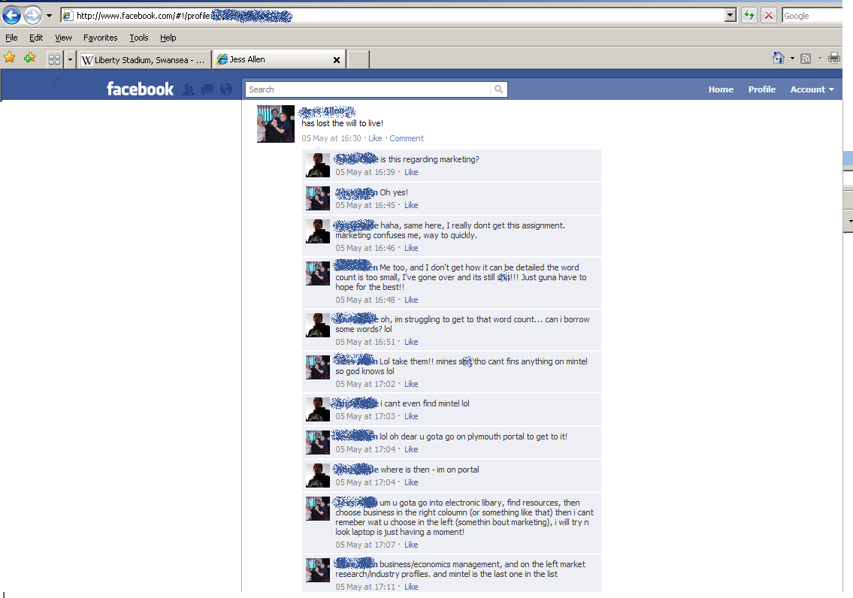
Notes:
Where are we going wrong? This task should be interesting, this task should be in the following day!

Slide 6

Lessons:
  Students don’t like reflection
  Students don’t like formative work
  Students don’t like ambiguity
  Students particularly hate working in groups where they actually have to engage in some sort of group management or dynamic or if it involves other people, or perhaps people who you have to speak to, or maybe people who, occasionally, you have to e-mail or facebook about work rather than about L2 or Zone, or ones that if you don’t ask them do the work they do it the same speed as you which mean that you actually have to manage yourself…..
http://www.h8u.de/abandon.jpg
Notes:
Reality is a little different than our theorised model

Slide 7
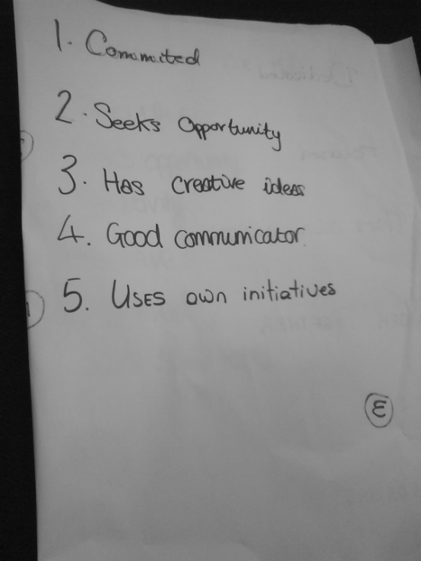
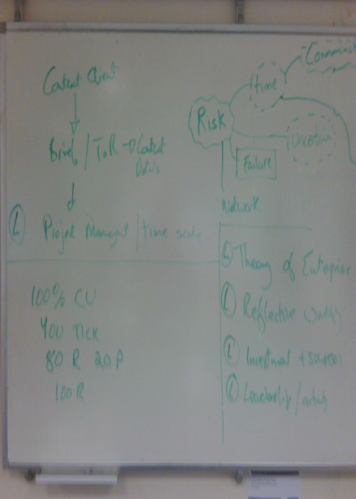
Enterprise Portfolio
Expose students to LO
Develop marking criteria through workshop
Formative challenges
Reflections
Author term 2 SoW
Notes:
Ok so here is where we went. Starting with the Learning outcomes.

Slide 8
Four issues
Enterprise
group
ambiguity
reflection
risk

Slide 9
Issues
Team
Ambiguity
Realism
Grade
Realism
Quality Assurance
Risk
Reflection
Realism
Grade
Ambiguity
Motivation
Grade

Slide 10
Issues
Team
Ambiguity
Realism – short notice
Grade - professionalism
Realism - hardest
Quality Assurance – ignore?
Risk
Reflection
Realism – options on grading
Grade – manage?
Ambiguity – decision making under uncertainty
Motivation – maybe it is too much
Grade – too generous

